Slide 1
Under Armour: Innovation
Ian Robertson

Slide 2
Shoe Innovation Search
OBJECTIVES:
Find videos that express innovative uses pertaining to shoes.
Identify context, creative expression, innovative components (nomenclature) on various parts of the anatomy.

Slide 3
The Feed Query
https://<GoogleAPI>/search?part=snippet&order=date&q=shoe%7Cshoes&relevanceLanguage=en&maxResults=20&fields=items(id,snippet(title,description,channelId,channelTitle,publishedAt,liveBroadcastContent))&type=video&key=<KEY>

Slide 4
Terms Briefing
Positive and Negative Terms.
Impacts scoring. See, “terms_score” in Kibana.
+1 for positive terms, -1 for negative terms.
Videos w/ score at or below 0 are typically non-conducive.
Vital Considerations:
Nomenclature
Anatomy
Creative Expressions
Uniqueness
In all probability, a video of a unique innovation will have attributes of all four.

Slide 5
Nomenclature
Laces, arch, outsole, insole, vamp, welt, eyelet, leather, material, quarter, tongue, feather, lining, seat, shank, throat, waist, puff, upper, lower

Slide 6
Anatomy
Ankle, arch*, men, women, toes, calf, legs, comfort*, fit, motion, muscles, length, width, health, foot, feet, round, flat, curve

Slide 7
Prepositions, individual, and possessive terms
For, my, mine, I, I am, I’m, you’re, your, man, woman

Slide 8
Creative Expressions
Design, designed, pattern, patent, tech, technology, latest, innovation, idea, create, creation, created, running, develop, developed, tested, test

Slide 9
Shoes
words = ['laces', 'ankle','arch','foot','feet','wear','design','designed','heel','tested','test','outsole','sole','puff','shank','waist','upper','lower','throat','seat','tongue','feather', 'lining','mens','womans','going','completed','muscles','muscle','motion','length','width','health','fitness','vamp','welt','insole','eyelet','toe','toes','leather','material','calf','leg','pattern','quarter','patent','man','men','woman','women','resist','resistant', 'weather','develop','developed','built','comfort','stability', 'grip', 'lacing', 'round', 'flat', 'curve', 'fit', 'tech', 'technology', 'latest', 'lace', 'for', 'running', 'run', 'my', 'new', 'innovation', 'idea', 'create', 'creation', 'created']

Slide 10
Negative Words
negate_words = [ 'nike', 'brooks', 'collection', 'collect', 'jordan', 'curry','lonzo','lebron','durant','lavar','subscribe','reebok', 'adidas', 'northface', 'newbalance', 'review', 'sale', 'offer', 'live','cheap','ebay','discount','amazon', 'buy', 'top', 'best', 'how', 'free' ]

Slide 11
Negation
OBJECTIVES:
Remove Reviews, How-to’s
Remove Competitors and their references
Remove sales pitches (free, cheap, ebay, amazon, discount)
Negate Athletes (Jordan, Curry, LeBron)
Negate professional channels (subscribe)

Slide 12
Decay function – The distance between words and
Propagation – Occurances, duplicates and synonmys
Coercion - synonyms

Slide 13
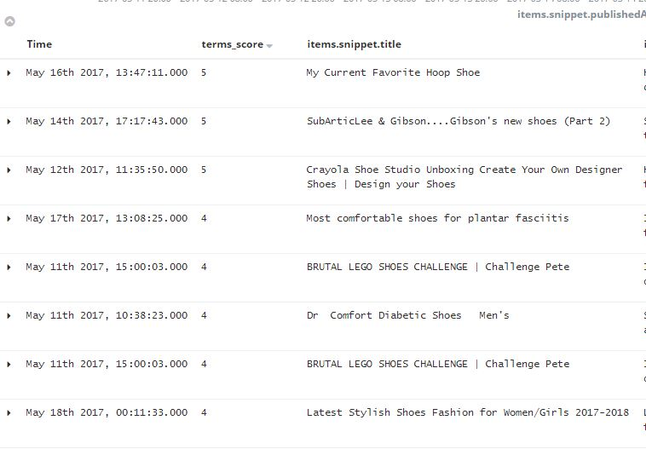
Last Week Highest Scoring

Slide 14
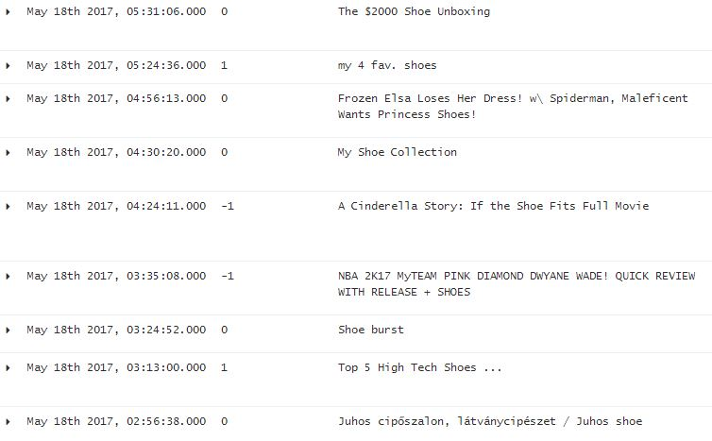
Latest Videos

Slide 15
SOC17 - Lake MX421 Endurance Cycling Shoe
https://www.youtube.com/watch?v=GmGGLOeXQvs

Slide 16
Statistics (as of May 10th)
Past 30 days Average 143 videos per day with references to shoes
Past 7 days Average 127 videos per day for a total of 4297 and 884 videos respectively.

Slide 17
The Algorithm
Written in Ruby
Runs within Logstash, Outputs to Elasticsearch, viewed on Kibana (UI)
Performs: Tagging => Preprocessing => parsing => aggregation of terms => by-word parsing then looping => scoring => labeling => insert back into Backend.
Located: /etc/logstash/conf.d/query-shoe.conf

Slide 18
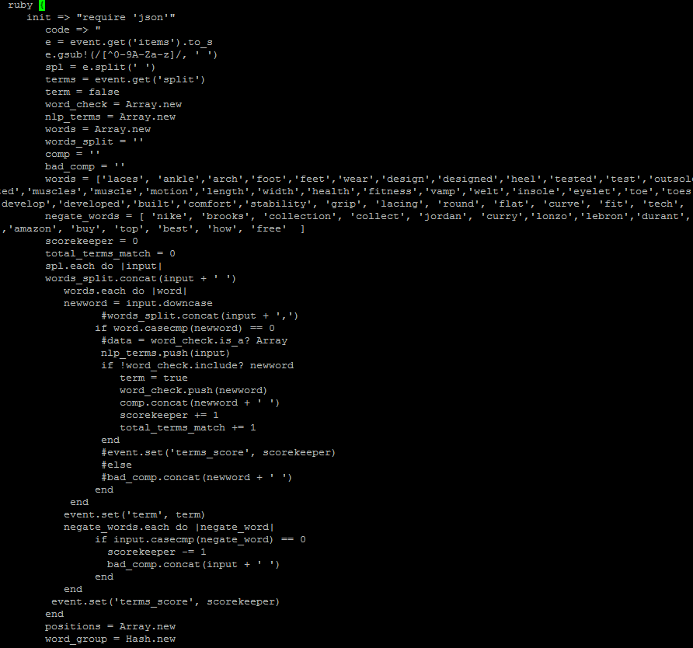

Slide 19
CAN
Only score CAN words: Creative, Anatomy, Nomenclature
Usage: per each CAN word in C(sub-i) recursively move to last starter word and count distance for Distance Vector.
Identify distance between critical words and directional word flow pattern.
i.e. “My new welt design” or “This new insole technology I designed”

Slide 20
Innovation pre-cursors
A silly easy way to keep your running shoes in top condition.
https://www.youtube.com/watch?v=uawNiGjAcgY
Differences Between Hard and Clay Court Tennis Shoes (w/ Bethanie Mattek-Sands)
https://www.youtube.com/watch?v=MyANkWDXUyQ
Ladies Gym Trainers Walking Trainers Womens Fitness Lightweight Sports Running Shoes
A1nxV3WWFg
Crayola Shoe Studio Unboxing Create Your Own Designer Shoes | Design your Shoes
Dc6RUdG40Fk

Slide 21
Videos
Dr Comfort Diabetic Shoes Men's
I_jULmsvLlc
Get inspired - passion and craftmanship for cycling shoes @ Northwave - “The development of a cycling shoe. Inspired by the needs of the athletes and realised with a combination of pure craftmanship and high technology.”
3RNkEeiIQJ0

Slide 22
Q and A

